Slide 1

Portfolio Of Evidence
Contract Monthly Claim System
Khutjo Mamabolo
ST10438214
PROG6212

Slide 2
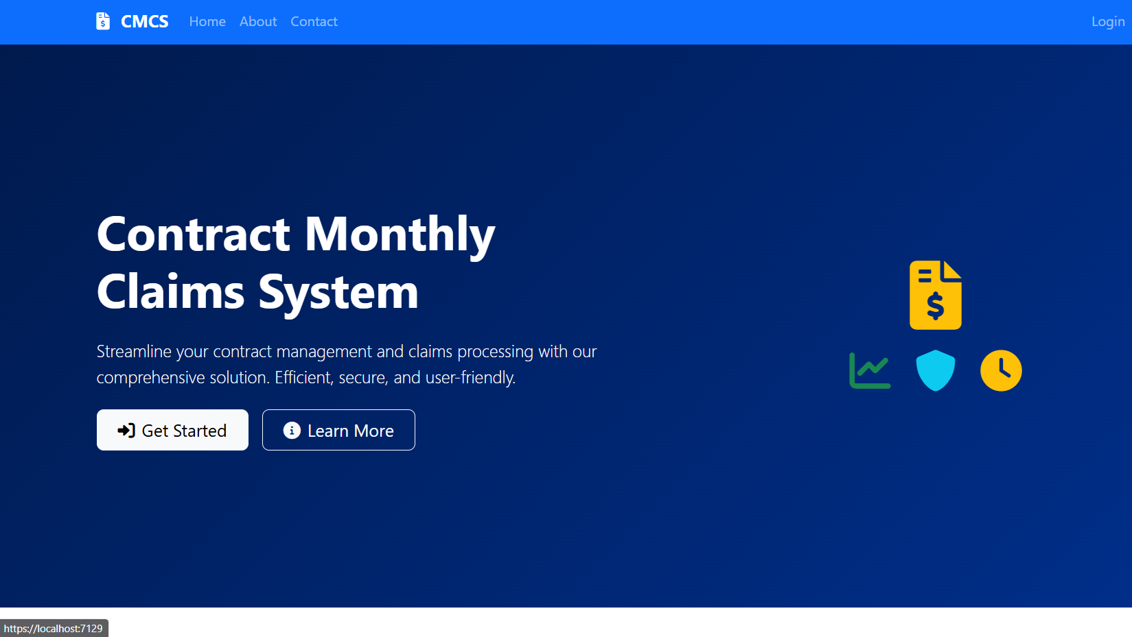
Landing Page
The picture attached displayed shows landing page which is the first page that the user sees. It features a hero section, navbar, and buttons that lead to the sign up/ login section towards the dashboard

Slide 3
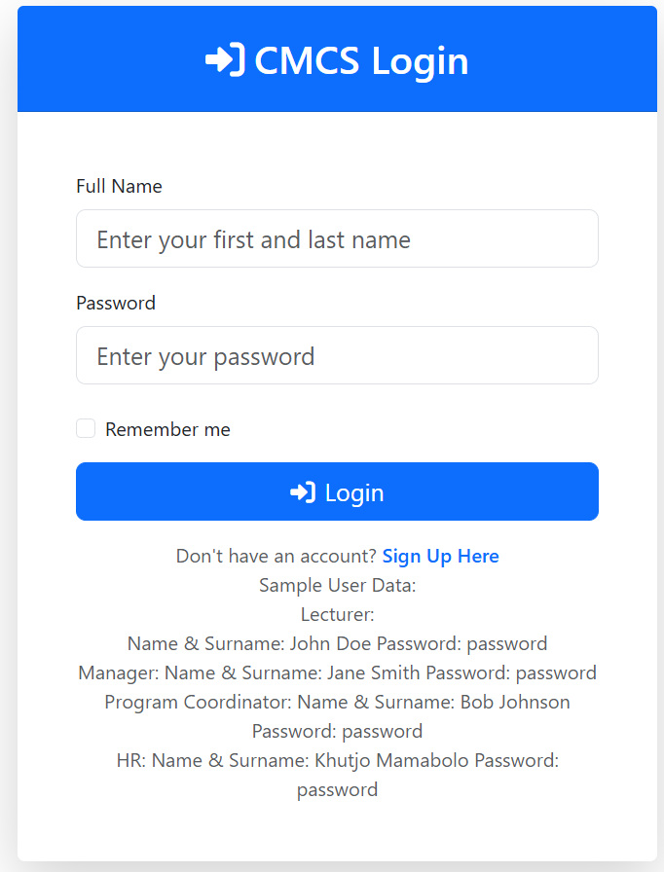
Login
The attached picture displays the login form that allows for users to log in to their respective dashboard.

Slide 4
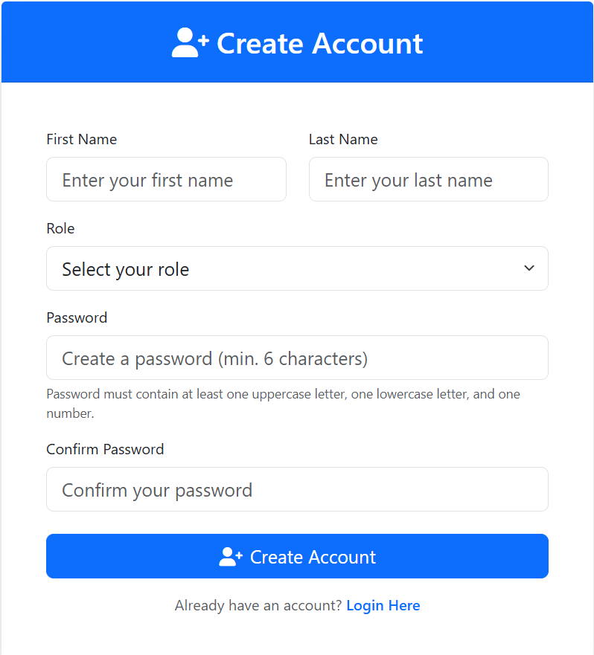
Sign In
This section allows for users to register /sign up with their respective job roles within the school. E.g. Lecturers, HR, Managers, and Program Coordinators

Slide 5
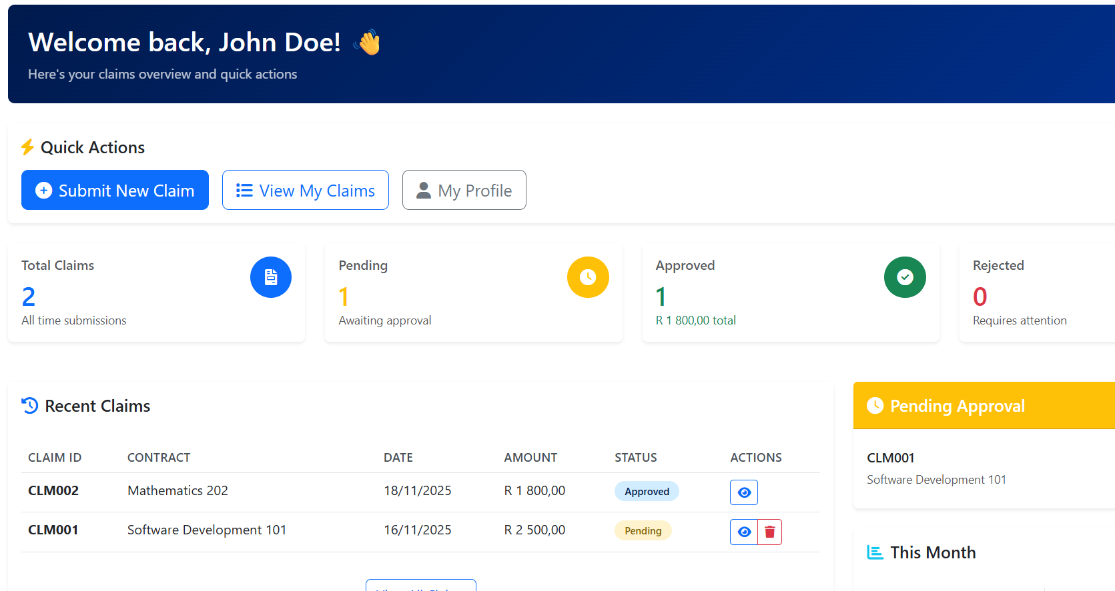
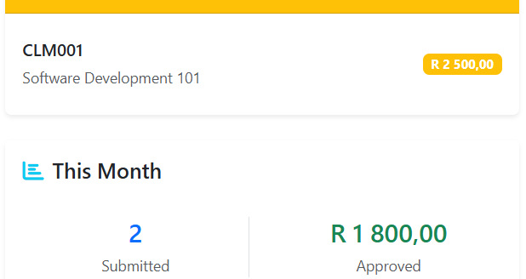
Lecturers Dashboard
This is the dashboard that lets lecturers view their claim status and how many claims they had submitted. It allows for lecturers to also submit a claim

